Slide 1
Deep Learning
Santosh GSK
Industry Expert

Slide 2
What is Deep Learning?
A machine learning subfield of learning representations of data, where we use algorithms that attempt to learn (multiple levels of) representation by using a hierarchy of multiple neural layers
If you provide the system tons of information, it begins to understand it and respond in useful ways.
DL is exceptionally effective at learning patterns.

Slide 3
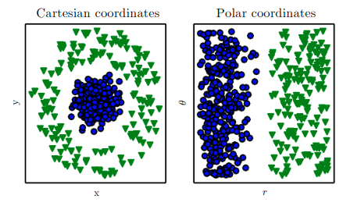
Background - Machine Learning Example
Suppose we want to separate two categories of data by drawing a line between them in a scatterplot.
In the plot on the left, we represent some data using Cartesian coordinates, and the task is impossible.
In the plot on the right, we represent the data with polar coordinates and the task becomes simple to solve with a vertical line.

Slide 4
Solution
Use Machine Learning to discover not only the mapping from representation to output but the representation as well
This is called Representation Learning
Enable AI systems to rapidly adapt to new tasks with minimal human intervention
Manually designing features for complex task requires a great deal of human effort
The quintessential example of representation learning is autoencoder.

Slide 5
Drawbacks of traditional learning
A major source of difficulty in many real-world AI applications is that factors of variation influence every single example of data we observe
Most applications want us to disentangle the factors of variation and discard the ones we do not care about
Many of these factors of variation, such as speaker’s accent (in Speech Recognition), can be identified only using sophisticated, nearly human-level understanding of data
When it is nearly as difficult to obtain a representation as to solve the problem, representation learning does not, at first glance, seem to help us

Slide 6
Deep Learning to rescue
DL solves these problems in representation learning by introducing representations that are expressed in terms of other, simpler representations
DL enables the computer to build complex concepts out of simpler concepts.
Other challenges like understanding non-linearity, complex data-types, feature engineering can also be solved efficiently using Deep Learning

Slide 7

MLP vs Deep Learning

Slide 8
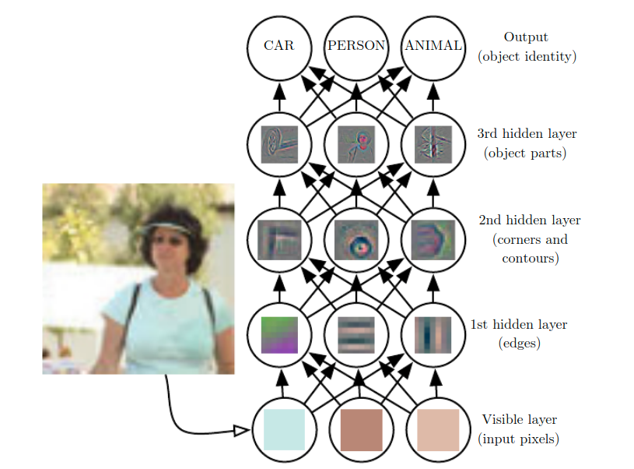
Illustrations of a Deep Learning Model
Learning or evaluating such mapping seems insurmountable if tackled directly
DL solves this mapping by breaking a complicated mapping into nested simple mappings, each described at a layer
A series of hidden layers extract abstract features from the image. These layers are called “hidden” because these values are not given in the data
The visualizations are a representation of features at each hidden layer
Given the input pixels, the first layer identifies the edges
The second layer can search for corners and contours which are recognizable as collection of edges

Slide 9
Illustrations of a Deep Learning Model
Given the second layer’s representation of edges, the third layer can detect entire parts of a specific objects
Finally, this description of image in terms of object parts it contains can be used to recognize the objects present in the image

Slide 10
Depth of a model
The idea of learning the right representation for the data provides one perspective on deep learning.
Another perspective on deep learning is that depth allows the computer to learn a multi-step computer program
Each layer of the representation can be thought of as the state of the computer’s memory after executing another set of instructions in parallel.
Networks with greater depth can execute more instructions in sequence.
Sequential instructions offer great power because later instructions can refer back to the results of earlier instructions.

Slide 11
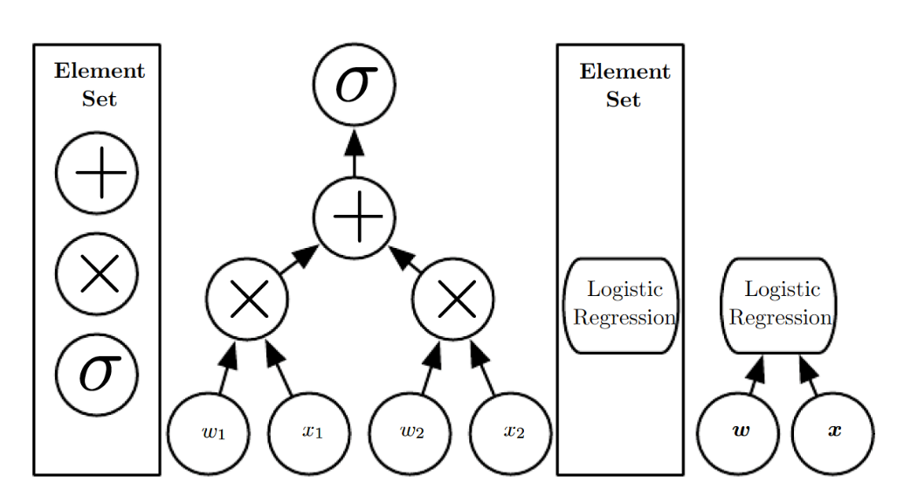
Depth of a model
There are two main ways of measuring the depth of a model
The first view is based on the number of sequential instructions that must be executed to evaluate the architecture.
We can think of this as the length of the longest path through a flow chart that describes how to compute each of the model’s outputs given its inputs.
Just as two equivalent computer programs will have different lengths depending on which language the program is written in,
The same function may be drawn as a flowchart with different depths depending on which functions we allow to be used as individual steps in the flowchart.

Slide 12
Depth of a model
2. Another approach, used by deep probabilistic models, regards the depth of a model as being not the depth of the computational graph but the depth of the graph describing how concepts are related to each other.
This is because the system’s understanding of the simpler concepts can be refined given information about the more complex concepts.
For example, an AI system observing an image of a face with one eye in shadow may initially only see one eye. After detecting that a face is present, it can then infer that a second eye is probably present as well.
The graph of concepts only includes two layers—a layer for eyes and a layer for faces—but the graph of computations includes 2n layers if we refine our estimate of each concept given the other n times.

Slide 13
Depth of a model
Because it is not always clear which of these two views is most relevant, and
There is no single correct value for the depth of an architecture, just as there is no single correct value for the length of a computer program.
Nor is there a consensus about how much depth a model requires to qualify as “deep.”
However, deep learning can safely be regarded as the study of models that either involve a greater amount of composition of learned functions or learned concepts than traditional machine learning does.
Deep learning is a particular kind of machine learning that achieves great power and flexibility by learning to represent the world as a nested hierarchy of concepts,
with each concept defined in relation to simpler concepts, and
more abstract representations computed in terms of less abstract ones

Slide 14
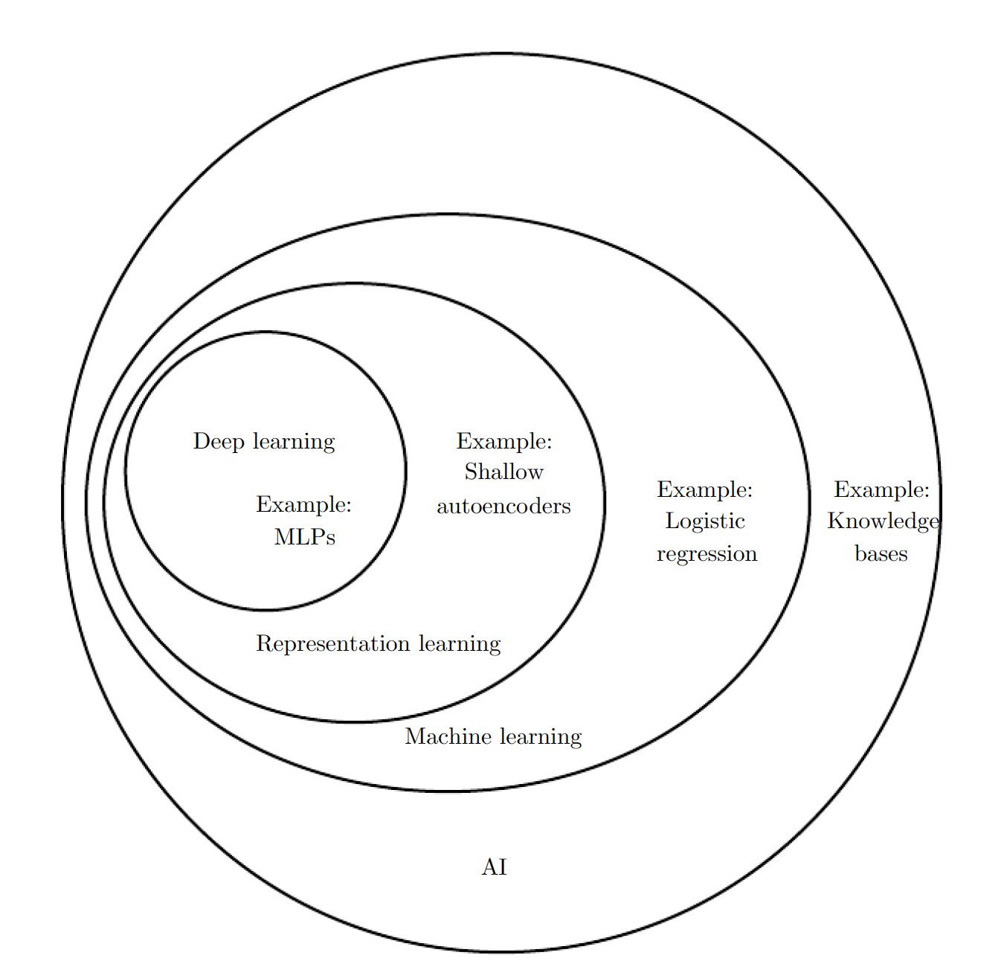
Deep Learning and AI

Slide 15
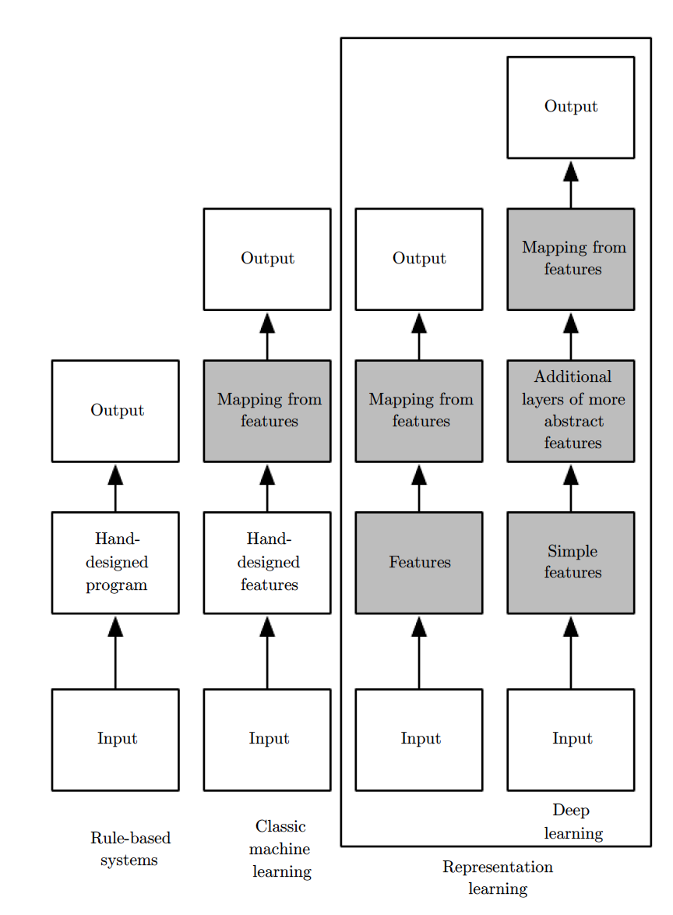
Flowchart of AI concepts

Slide 16

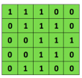
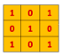

Convolutional Neural Networks
✱
Convolutional
3x3 filter
Input Image

Slide 17
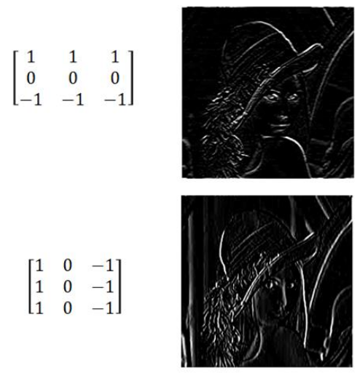
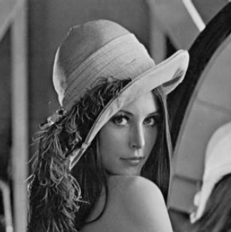
CNN – Filters

Slide 18
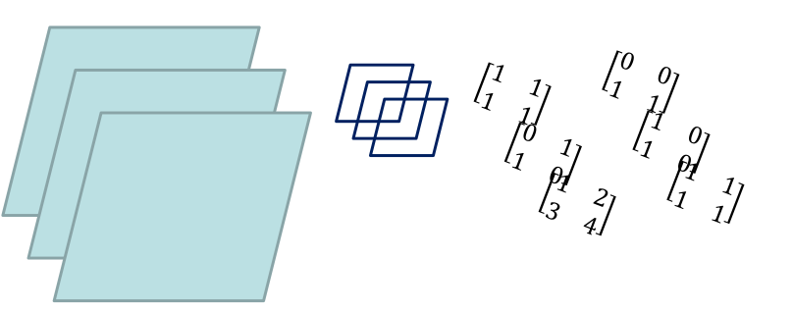
Convolution in 3 dimensions
= (1*0)+(1*0)+(1*1)+(1*1)+
(0*1)+(1*0)+(1*1)+(0*0) +
(1*1)+(2*1)+(3*1)+(4*1)
= 13
Even a 3D convolution gives a 2D output

Slide 19
CNN Summary
To summarize, the Conv Layer:
Accepts a volume of size W₁×H₁×D₁
Requires four hyperparameters:
Number of filters K,
their spatial extent F,
the stride S,
the amount of zero padding P.
Produces a volume of size W₂×H₂×D₂ where:
W₂=(W₁−F+2P)/S + 1
H₂=(H₁−F+2P)/S + 1
D₂=K
With parameter sharing, it introduces F⋅F⋅D₁ weights per filter, for a total of (F⋅F⋅D₁)⋅K weights and K biases.
A common setting of the hyperparameters is F=3,S=1,P=1. But varies for different types of problems and architectures.

Slide 20
Why do CNNs work?
The networks can be large and hence bias is minimized
The weights are mostly zero because of convolution.
ReLU(Activation Function) and Dropout makes even fewer weights.
Hence, variance is minimized

Slide 21
When Context is important
Sometimes, we need to have the contextual information to be able to perform Machine Learning predictions
E.g., Estimating the probabilities of words given the context
The clouds are in the ___ (sky – no further context is needed)
I fell in love with this French girl. My parents were against it initially as they were worried about the cultural differences. However, after they met her they realized how wonderful a person she is and agreed for our marriage. All that is left is convincing her parents. Here, I am booking my tickets to ______ (A lot of context is needed)

Slide 22
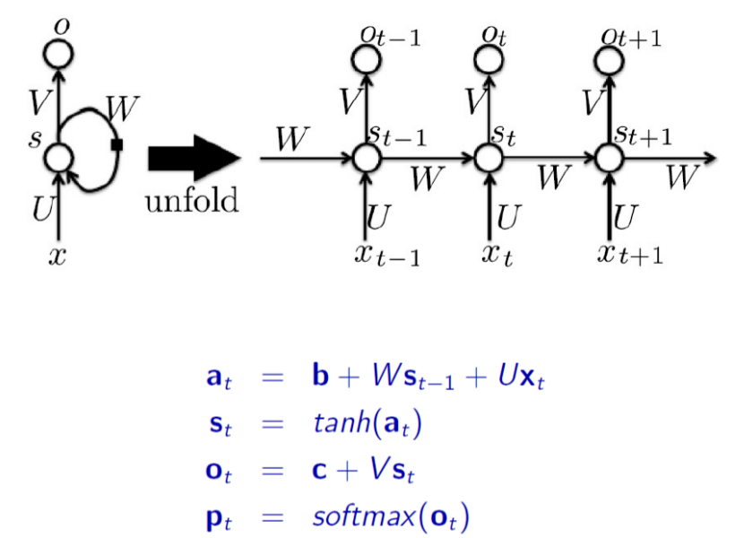
Recurrent Neural Network (RNN)

Slide 23
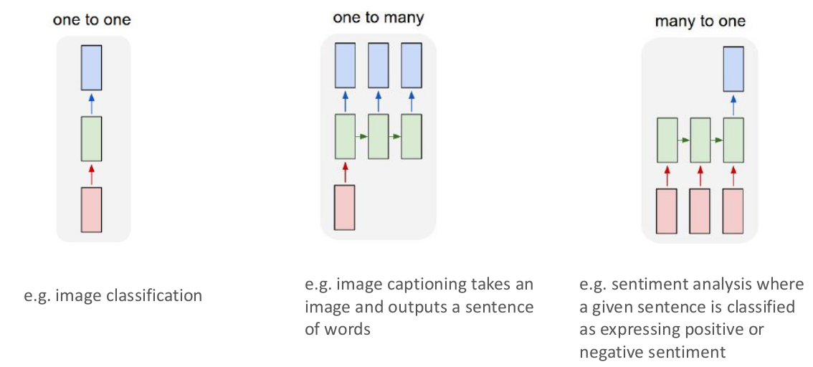
Tasks where context is useful

Slide 24
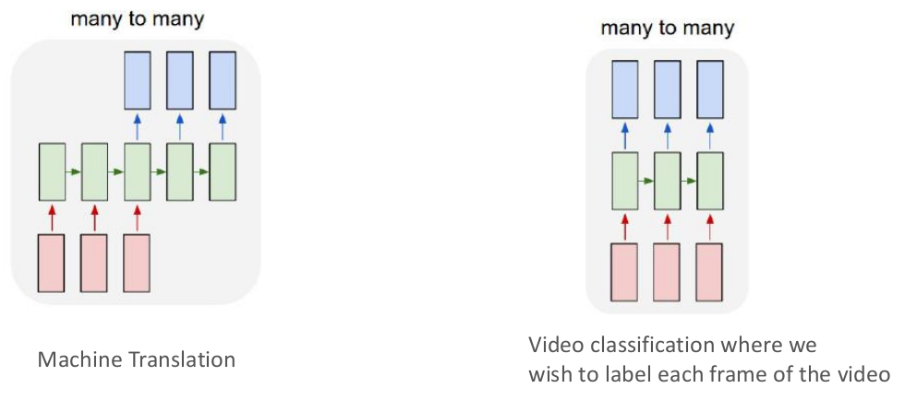
Tasks where context is useful

Slide 25
Thank You!
In our next session:
Optimization Models

